Slide 1
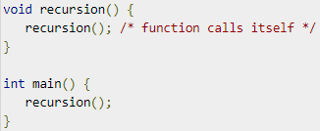
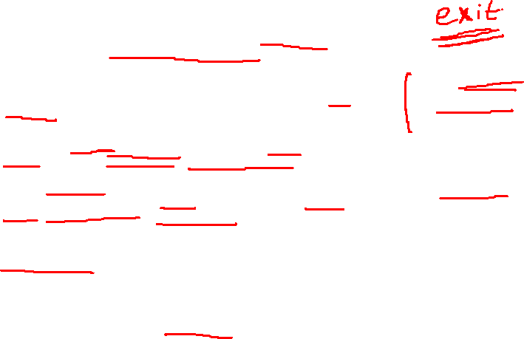
Recursion is the process of repeating items in a self-similar way. In programming languages, if a program allows you to call a function inside the same function, then it is called a recursive call of the function.
The C programming language supports recursion, i.e., a function to call itself. But while using recursion, programmers need to be careful to define an exit condition from the function, otherwise it will go into an infinite loop.
Generally, iterative solutions are more efficient than recursion since function call is always overhead. Any problem that can be solved recursively, can also be solved iteratively. However, some problems are best suited to be solved by the recursion, for example, tower of Hanoi, Fibonacci series, factorial finding, etc.
Recursion cannot be applied to all the problem, but it is more useful for the tasks that can be defined in terms of similar subtasks. For Example, recursion may be applied to sorting, searching, and traversal problems.
Recursive functions are very useful to solve many mathematical problems, such as calculating the factorial of a number, generating Fibonacci series, etc.

Slide 2
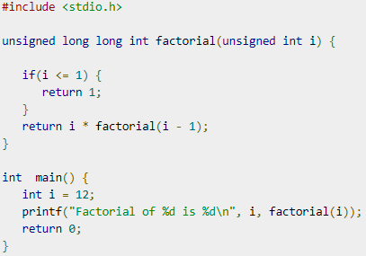
Factorial of a number using recursion

Slide 3
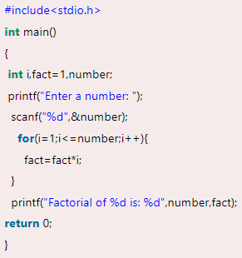
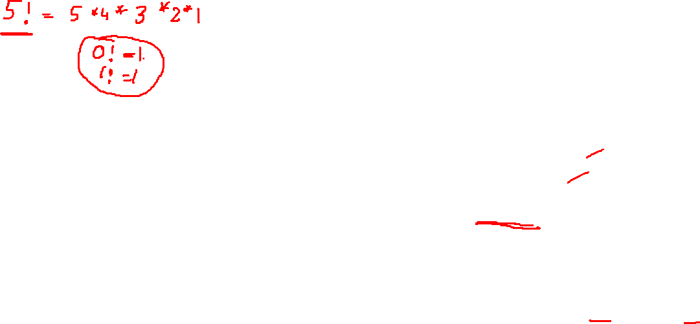
Factorial of number using iteration

Slide 4
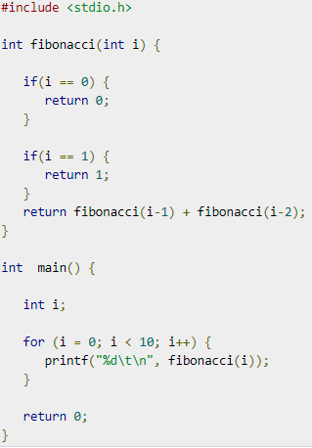
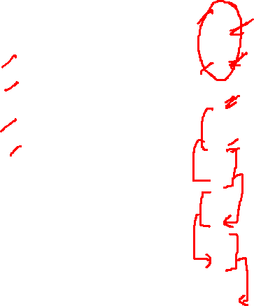
Fibonacci series

Slide 5
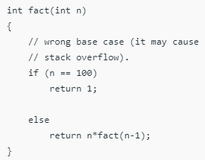
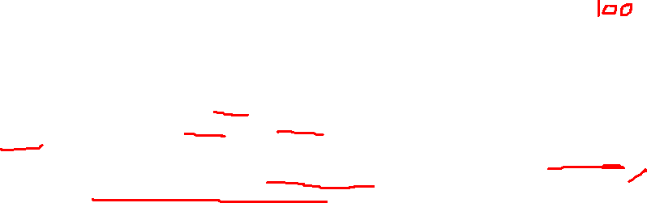
Stack Overflow
The idea is to represent a problem in terms of one or more smaller problems, and add one or more base conditions that stop the recursion. For example, we compute factorial n if we know factorial of (n-1). The base case for factorial would be n = 0. We return 1 when n = 0.
If the base case is not reached or not defined, then the stack overflow problem may arise.
If fact(10) is called, it will call fact(9), fact(8), fact(7) and so on but the number will never reach 100. So, the base case is not reached. If the memory is exhausted by these functions on the stack, it will cause a stack overflow error.

Slide 6
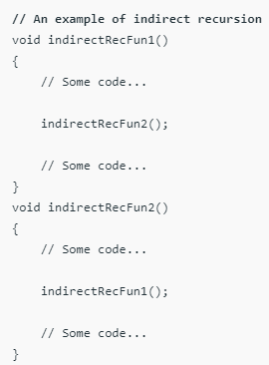
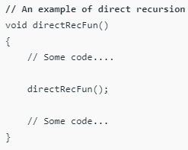
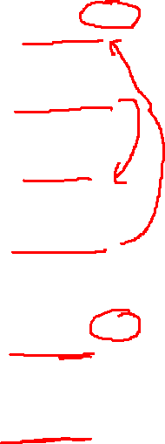
Direct and Indirect recursion
A function fun is called direct recursive if it calls the same function fun.
A function fun is called indirect recursive if it calls another function say fun_new and fun_new calls fun directly or indirectly.

Slide 7
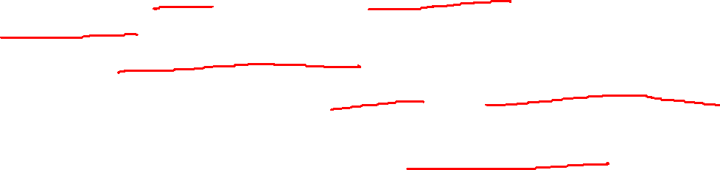
Memory allocation for recursion
Each recursive call creates a new copy of that method in the memory. Once some data is returned by the method, the copy is removed from the memory.
Since all the variables and other stuff declared inside function get stored in the stack, therefore a separate stack is maintained at each recursive call. Once the value is returned from the corresponding function, the stack gets destroyed.
Recursion involves so much complexity in resolving and tracking the values at each recursive call. Therefore we need to maintain the stack and track the values of the variables defined in the stack.

Slide 8
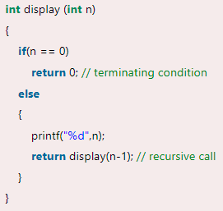
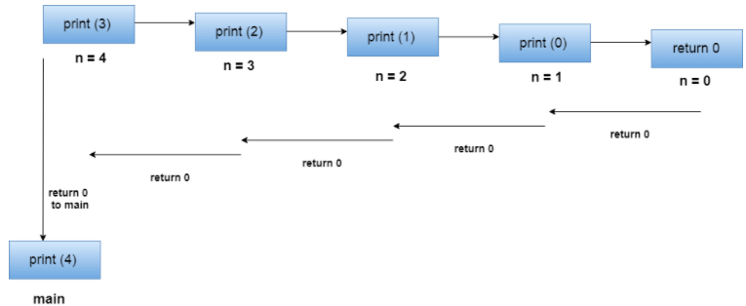
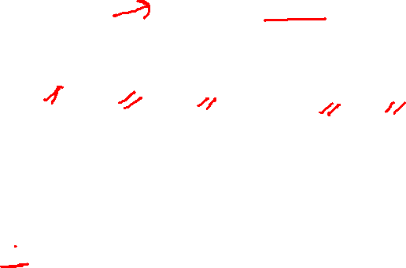
Let us examine this recursive function for n = 4. First, all the stacks are maintained which prints the corresponding value of n until n becomes 0,
Once the termination condition is reached, the stacks get destroyed one by one by returning 0 to its calling stack. Consider the following image for more information regarding the stack trace for the recursive functions.

Slide 9
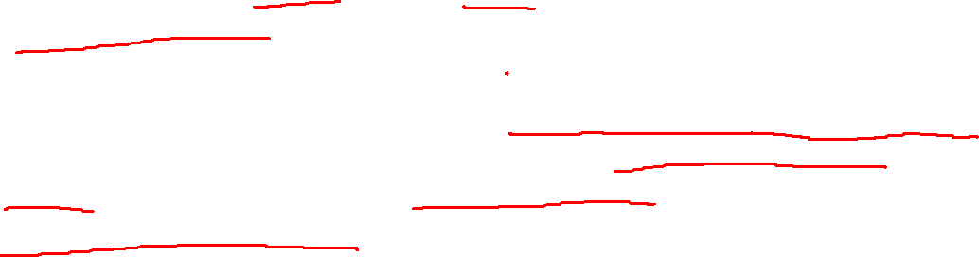
Disadvantages of recursive programming over iterative programming
Note that both recursive and iterative programs have the same problem-solving powers, i.e., every recursive program can be written iteratively and vice versa is also true.
The recursive program has greater space requirements than iterative program as all functions will remain in the stack until the base case is reached. It also has greater time requirements because of function calls and returns overhead.

Slide 10
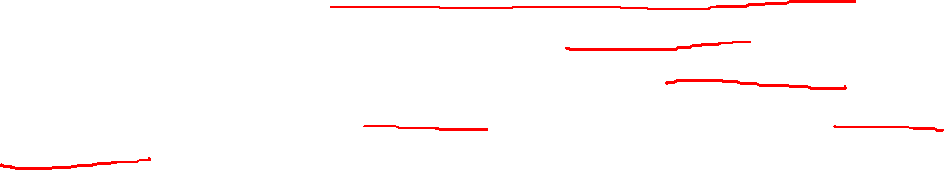
Advantages of recursive programming over iterative programming
Recursion provides a clean and simple way to write code. Some problems are inherently recursive like tree traversals, Tower of Hanoi, etc. For such problems, it is preferred to write recursive code. We can write such codes also iteratively with the help of a stack data structure.

